Slide 1
Particle Swarm Optimization (and it’s variants)
Justin Maltese

Slide 2
Presentation Topics
Introduction to Particle Swarm Optimization (PSO)
Extending PSO to multi-objective environments
Incorporating co-operation within PSO
Co-operative PSO for multi-objective environments
Tackling high-dimensional multi-objective problems using random grouping

Slide 3
Particle Swarm Optimization
Population-based stochastic optimization algorithm developed by Kennedy and Eberhart [1]
Modelled after the real-world flocking behaviour observed in bird species.
Initially designed to tackle single-objective problems

Slide 4
Particle Swarm Optimization
Population of simple entities maintained which are known as particles
Particles attempt to iteratively converge around desirable search space positions
The quality of a particle position is determined by a fitness function relating to the problem at hand

Slide 5
Cognitive component (c1) – influence of the personal best position found (pbest )
Social component (c2) – influence of the swarm collective via the global best position found (gbest)
Inertia component (ω) – influence of the previous computed velocity Random, stochastic component
(r1,r2) – uniform random vectors with component values between 0 and 1

Slide 6
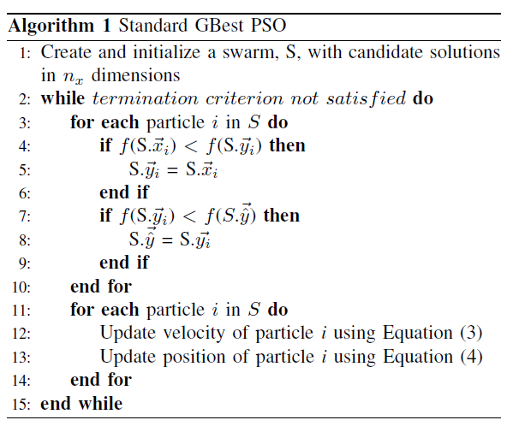

Slide 7
Observations in Previous Literature
Can use a ring topology instead of star, resulting in neighbourhoods of particle attraction
Engelbrecht [2] showed that setting initial particle velocity to 0 gives better performance

Slide 8
Extending PSO to multi-objective environments
Original PSO requires modification for multi-objective problems (MOPs) – problems which have multiple (often conflicting) objectives.
Initial idea was to use a weighted sum of all objectives.
Later on, the vector-evaluated PSO (VEPSO) algorithm was proposed in [3] which utilized a pareto ranking approach for MOPs.

Slide 9
Pareto Ranking
Generally refers to a state of resources in which a single individual cannot be improved without worsening another
Within the context of MOPs, a pareto optimal solution is one in which no further improvements can be made to an objective without negatively impacting another
Goal of Pareto approaches is to obtain the set of Pareto optimal solutions (Pareto Front)

Slide 10
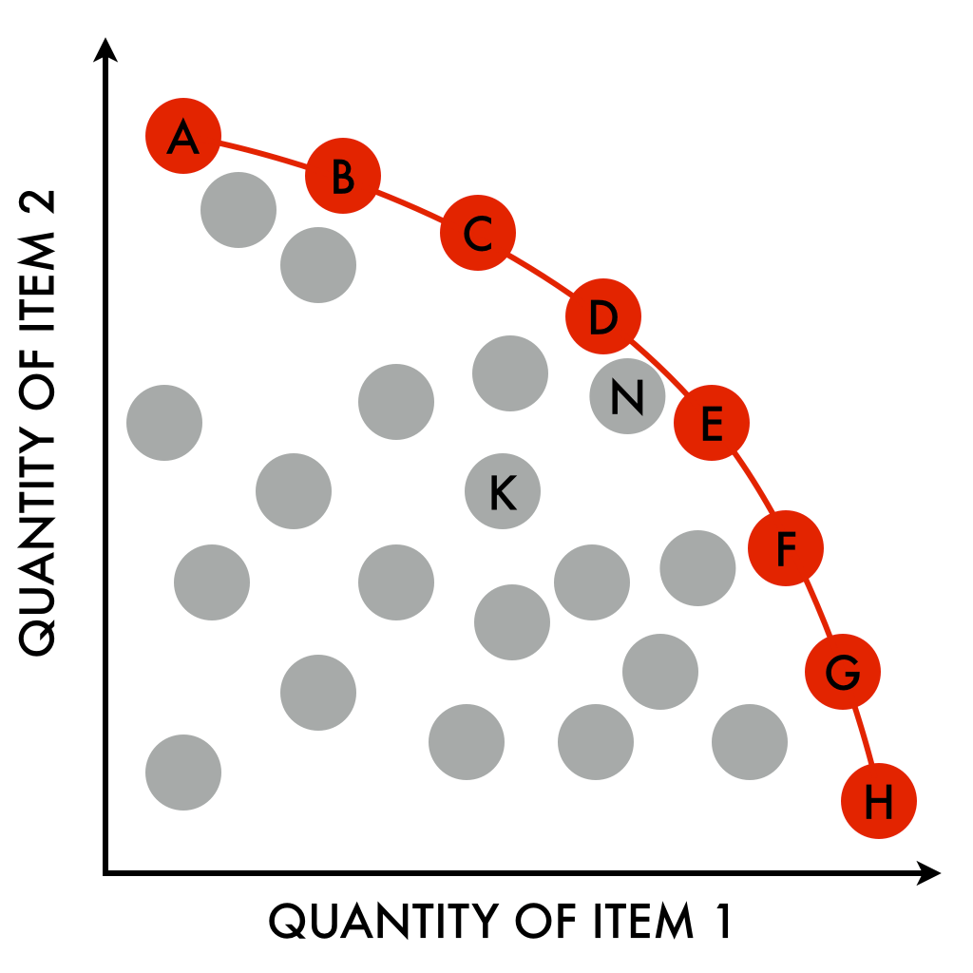

Slide 11

Multi-objective Performance Metrics
Solution Distribution:
Measure introduced in [5] which represents the distribution of solutions along the current front.
Euclidean distance is used to measure the distance between solutions
Lower score is more desirable. Score is also partially dependent on the number of solutions.

Slide 12
Hypervolume:
The hypervolume [4] defines a measure of space covered by a set.
Hypervolume of the objective space that is weakly dominated by an approximation set S.
Favors solutions close to the Pareto front. Maximal score is obtained if and only if the approximation front contains maximally diverse solutions.

Slide 13
VEPSO
Particle fitness now evaluated as a vector rather than a scalar value
A structure, denoted the archive, is used to hold non-dominated solutions (Pareto front)
Each objective is assigned a single swarm dedicated to optimization of the given objective

Slide 14
VEPSO Phases
1. Evaluate particle quality and update personal/global best positions
2. Transfer of knowledge between swarms using a pre-determined strategy
3. Archive maintenance
4. Particle position/velocity updating

Slide 15
Knowledge Transfer
To ensure that the problem is still optimized as a whole, VEPSO utilizes a knowledge transfer strategy (KTS) to pass information between swarms
Specifically, a KTS defines how global guides are determined, where a global guide is defined as a particle used in place of the typical global best particle in the PSO update equation.

Slide 16
Existing KTSs
Ring [3] - The global guide for a swarm is set to the global best particle from the neighbouring swarm in a circular ring fashion.
Random [6] - The global guide for a swarm is set to the global best particle from a randomly selected swarm. It is possible for a swarm to transfer knowledge to itself.

Slide 17
Existing KTSs
PCX Archive [7] - The global guide for a swarm is set to the result of the parent-centric crossover (PCX) operator applied to the position of three archive solutions, selected randomly.
PCX Gbest [7] - The global guide for a swarm is set to the result of the PCX operator applied to the global best position of three swarms, selected randomly.
*pBests used in the case of inadequate positions

Slide 18
Existing VEPSO Literature
Harrison et al. [7] explored the use of several different KTS within VEPSO. It was found that the PCX Gbest KTS was best in terms of hypervolume, while PCX Archive was dominant for the non-dominated solution distribution metric.
Matthysen et al. [8] have demonstrated that the KTS must be carefully selected, as choosing strategies prone to stagnation leads to performance degradation

Slide 19
Existing VEPSO Literature
Dibblee et al. [11] extended the VEPSO algorithm to include a local searching technique, formally proposed as the VEPSO-LS algorithm
It was found that using a simple hill-climber to improve the global best positions improves performance in problems with 2 objectives, but not 3

Slide 20
VEPSO With Local Search
Pbest-LS: A hill-climber is applied to the personal best positions of each swarm. This process is repeated every d iterations
Gbest-LS: A hill-climber is applied to the global best positions of each swarm. This process is repeated every d iterations
Nondominated-LS: A hill-climber is applied to all solutions of the archive
Dominated-LS: A hill-climber is applied to solutions which have been recently removed from the archive.

Slide 21
Co-operative PSO
Performance of the original PSO algorithm suffers in high-dimensional environments (curse of dimensionality)
To overcome this problem, Van den Bergh and Engelbrecht [9] proposed the co-operative PSO (CPSO) algorithm, later renamed to CPSO-S.
CPSO-S incorporates co-operative coevolution (CC) concepts, splitting the single swarm optimizing n dimensions into n 1-D swarms.

Slide 22
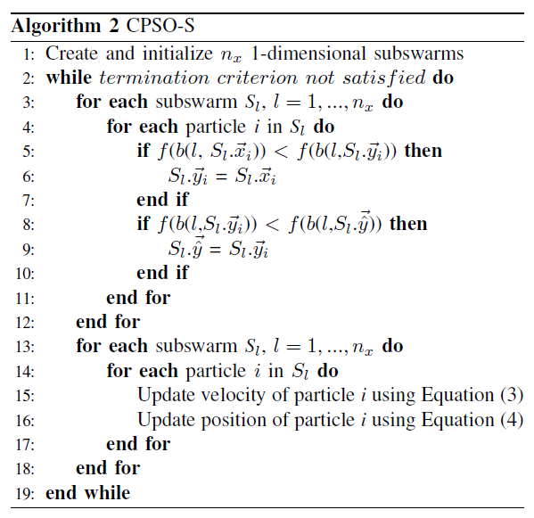

Slide 23
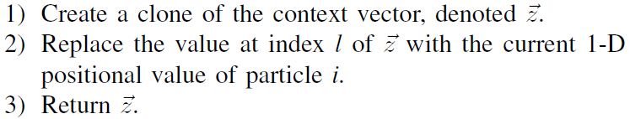
Algorithm 2
B is a function which takes a subswarm index and particle as input, returning a vector via the following process:

Slide 24
Advantages of CPSO-S
Search per subswarm is now in a lower dimensional space
Solution quality is now determined after each vector component is updated rather than when the entire vector has changed
Solution diversity is significantly increases due to the larger number of solution combinations formed

Slide 25
Additional CPSO Variants
CPSO-S suffers performance degradation when dependent variables are present, as they are considered in isolation
The CPSO-S_{k} algorithm [10] was proposed to alleviate this problem
CPSO-S_{k} splits the n-dimensional search space into k parts arbitrarily. Each swarm now optimizes n/k dimensions with the hope of grouping together dependent variables.

Slide 26
Additional CPSO Variants
CPSO-S and CPSO-S_{k} both experience a stagnation problem when faced with deceptive functions
To tackle this problem, Engelbrecht et al. introduced the hybrid CPSO-H_{k} algorithm [10] which executed PSO and CPSO-S_{k} sequentially
CPSO-H_{k} utilizes a KTS to transfer knowledge between CPSO-S_{k} and PSO swarms

Slide 27
Knowledge Transfer
CPSO-H_{k} transfers knowledge by injecting the best solution from the PSO swarm into the CPSO-S_{k} swarm and vice-versa.
Injection requires overwriting a particle’s dimensions by replacing them with the dimensions of a target particle.
To preserve diversity, only half of the total particles are considered legal candidates i.e particles which can be overwritten. Additionally, the best particles from each swarm are protected from overwrites.

Slide 28
Combining CPSO and VEPSO
It was shown in [10] that co-operation improves PSO in single-objective environments
Maltese et. al [12] investigated whether these conclusions hold for MOPs, specifically using the VEPSO algorithm
Several co-operative VEPSO (CVEPSO) variants were proposed. Each CVEPSO variant utilized a unique CPSO algorithm to perform optimization for each objective.

Slide 29
CVEPSO Variants
CVEPSO-S – VEPSO which utilizes CPSO-S swarms for optimization
CVEPSO-S_{k} – VEPSO which utilizes CPSO-S_{k} swarms for optimization
CVEPSO-H_{k} – VEPSO which utilizes CPSO-H_{k} swarms for optimization

Slide 30
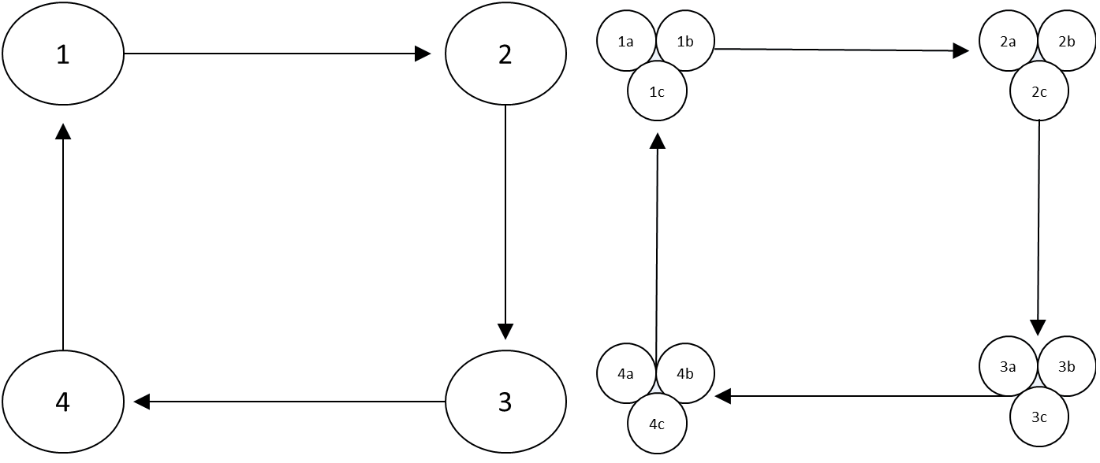
Architectural Differences
VEPSO
CVEPSO-S
*Problem shown contains three dimensions, four objectives. Chosen KTS is ring KTS.

Slide 31
CVEPSO implementation
Knowledge transfer is performed using the context vectors of each swarm
Archive addition uses context vectors. Each time a non-dominated context vector is found it is added into the archive. Archive removal strategies are identical to VEPSO (ideally distance-based to promote diversity.

Slide 32
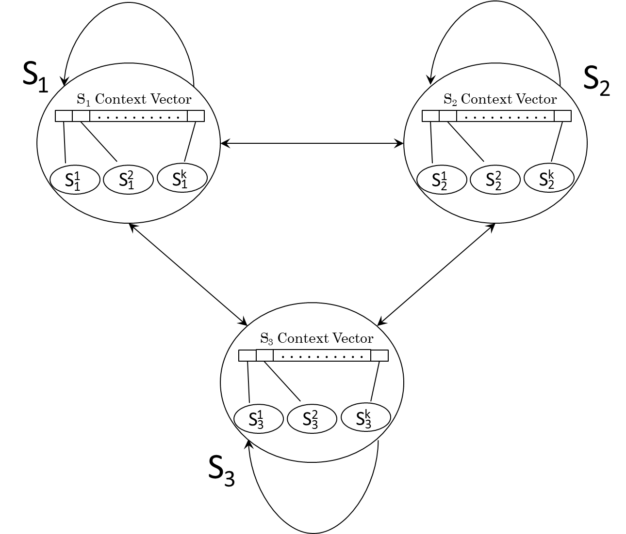
Knowledge Flow
*Problem shown contains three objectives. Chosen KTS is random KTS.

Slide 33
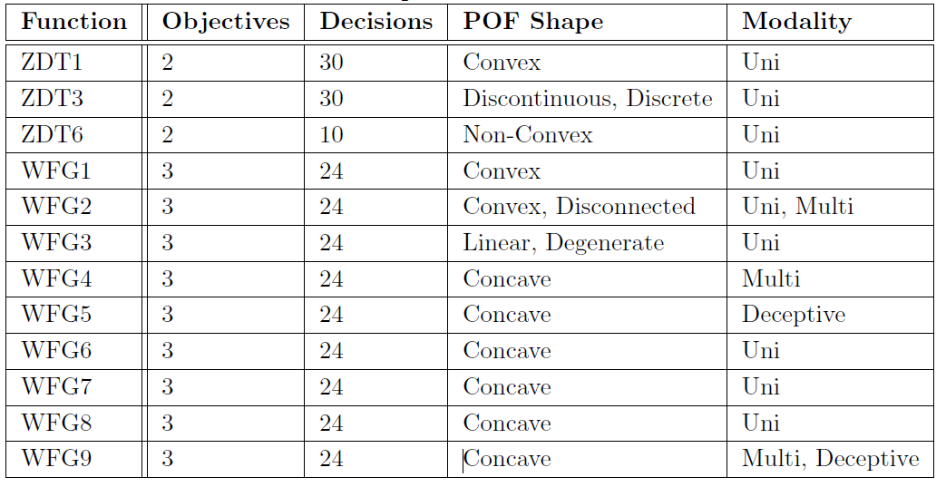
Test Problems

Slide 34
Results
Co-operation improves the performance of VEPSO, giving a more desirable hypervolume/solution distribution in nearly all cases
CVEPSO-S and CVEPSO-S_{k} were the best performing variants
A comparison against other top multi-objective algorithms was performed

Slide 35
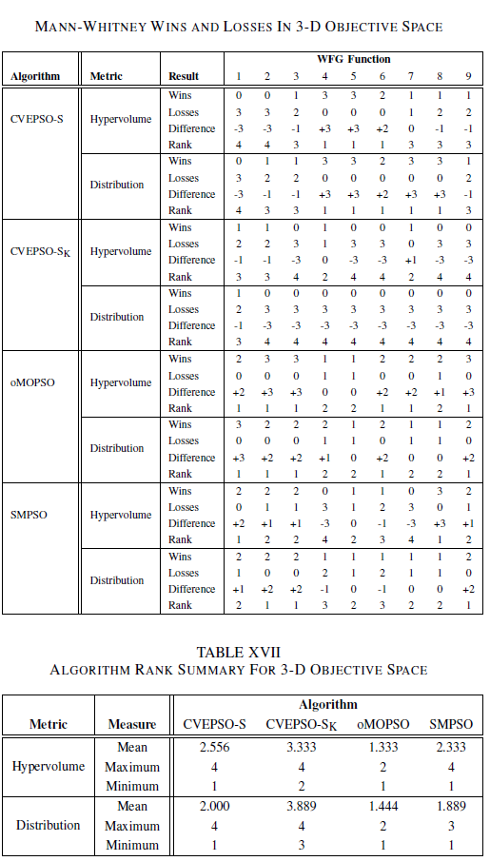
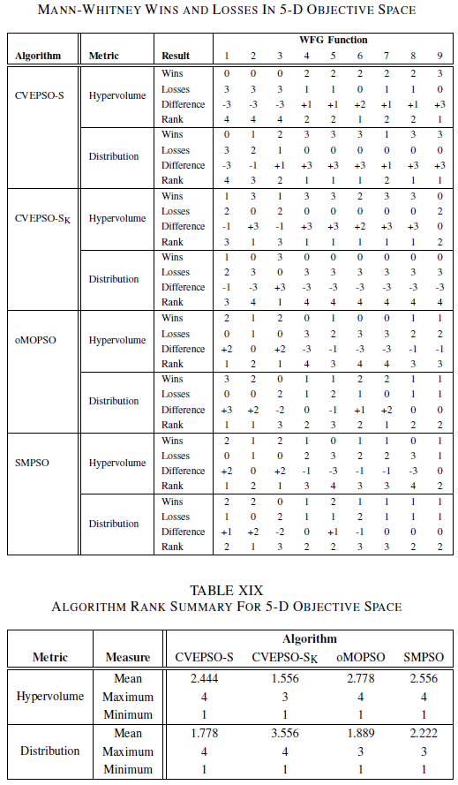
Comparison against other algorithms

Slide 36
CVEPSO Conclusions
CVEPSO fared well against other top algorithms with the exception of CVEPSO-S_{k} in 3-d objective space.
With regards to the 5-D experiments, CVEPSO-S distributed non-dominated solutions notably well while CVEPSO-S_{k} produced the best hypervolume.

Slide 37
Additional CVEPSO Literature
While CVEPSO performed well [12], there is room for improvement with respect to the grouping techniques used to decompose the decision vector.
The blind split of CVEPSO-Sk experiences performance degradation when dependent variables are not grouped together. As the number of dimensions increases, the probability of grouping dependent variables together becomes even lower.

Slide 38
CVEPSO-R_{k}
Maltese et. al [13] proposed the CVEPSO-R_{k} algorithm to tackle this dependent variable problem. CVEPSO-R_{k} is a dynamic extension of CVEPSO-S_{k} which regroups variables randomly [14] at each iteration
CVEPSO-R_{k} is intended to improve the VEPSO algorithm by increasing the probability that dependent variables are optimized together. This is especially important in high-dimensional environments.

Slide 39
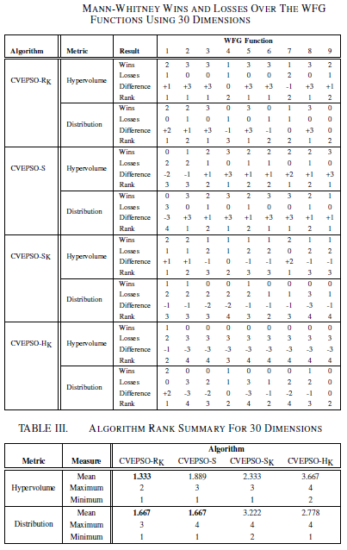
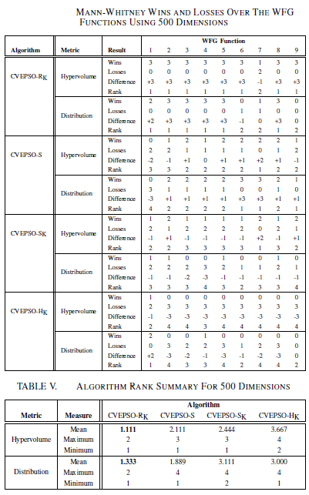
CVEPSO-R_{k} Results

Slide 40
CVEPSO-R_{k} Conclusions
CVEPSO-R_{k} is the best performing CVEPSO variant with respect to both hypervolume and non-dominated solution distribution.
The performance improvement is especially apparent for non-separable problems possessing a large number of dimensions (500+).
Additionally, CVEPSO-R_{k} was shown to perform better than two other multi-objective PSO algorithms (oMOPSO, SMPSO).

Slide 41
References
[1] J. Kennedy and R. C. Eberhart, “Particle swarm optimization," in IEEE int'l conference on neural networks, vol. IV, pp. 1942-1948, 1995.
[2] A. Engelbrecht, “Particle Swarm Optimization: Velocity Initialization," in Evolutionary Computation (CEC), 2012 IEEE Congress. June 2012, pp. 1-8.
[3] K. E. Parsopoulos, D. K. Tasoulis, and M. N. Vrahatis, “Multiobjective optimization using parallel vector evaluated particle swarm optimization," in Proceedings of the IASTED International Conference on Artificial Intelligence and Applications, vol. 2 of AIA 2004, pp. 823-828, ACTA Press, 2004.
[4]E. Zitzler and L. Thiele, “Multiobjective evolutionary algorithms: A comparative case study and the strength pareto approach," IEEE Trans. on Evolutionary Computation, vol. 3, pp. 257-271, November 1999.
[5] C. K. Goh and K. C. Tan, “An investigation on noisy environments in evolutionary multiobjective optimization," IEEE Trans. on Evolutionary Computation, vol. 11, no. 3, pp. 354-381, 2007.
[6]J. Grobler, A.P Engelbrecht and V.S Yadavalli, “Multi-objective de and pso strategies for production scheduling,” in 2008 IEEE World Congress on Computational Intelligence, J. Wang, Ed. Hong Kong: IEEE Press, 1-6 June 2008.

Slide 42
[7] K. Harrison, B. Ombuki-Berman and A. Engelbrecht. Evolutionary Multi-Criterion Optimization, Lecture Notes in Computer Science Volume 7811, 2013, pp. 171-184 , March 2013.
[8] W. Matthysen, A.P. Engelbrecht, and K. Malan, “Analysis of stagnation behaviour of vector-evaluated particle swarm optimization,” in Swarm Intelligence (SIS), 2013 IEE Symposium on, Aprl 2013, pp. 155-163
[9] F. van den Bergh and A.P. Engelbrecht. “Cooperative learning in neural networks using particle swarm optimizers”. In: South African Computer Journal (2000), pp. 84–90.
[10] F. van den Bergh and A.P. Engelbrecht. “A Cooperative approach to particle swarm optimization”. In: Evolutionary Computation, IEEE Transactions on 8.3 (June 2004), pp. 225–239. issn: 1089-778X. doi: 10.1109/TEVC.2004.826069.
[11] Derek Dibblee, Justin Maltese, Beatrice Ombuki-Berman and Andries Engelbrecht. " Vector-Evaluated Particle Swarm Optimization with Local Search". 2015 IEEE Congress on Evolutionary Computation, CEC 2015, Sendai, Japan, 2015 (accepted).
[12] Justin Maltese, Beatrice Ombuki-Berman and Andries P. Engelbrecht. “Cooperative Vector-Evaluated Particle Swarm Optimization ,” submitted (IEEE CEC 2015).
[13] Justin Maltese, Beatrice Ombuki-Berman and Andries P. Engelbrecht. “Cooperative Vector-Evaluated Particle Swarm Optimization With Random grouping for High-Dimensional Multi-objective Problems,” submitted (IEEE CEC 2015).
[14] Z. Yang, K. Tang, X. Yao, “Differential evolution for high-dimensional function optimization,” in Evolutionary Computation, 2007, IEEE Congress on. Sept 2007, pp. 3523-3530.

Slide 43
Questions/Comments?

